Slide 1
LeT’s dive deep togher in to the Leadership

Slide 2
What is leadership?
Is the process of influencing others, identifying and working towards a common goal.
Leadership is a skill like any other skill, it’s a practicable learnable skill.

Slide 3
Who is the leader?
Leaders are the ones who run headfirst into the unknown, they rush towards the danger, they put their own interest aside to protect us or to pull us into the future.
Leaders would sooner sacrifice what is theirs to save what is ours, and they would never sacrifice what is ours to save what is theirs.
This what it means to be a leader, it means they choose to go first into the danger, headfirst into the unknown.
And when we feel sure they will keep us safe, we will march behind them and work tirelessly to see their vision comes to life, and proudly call ourselves their followers.

Slide 4
If your action inspire others to dream more, learn more, do more and become more you are a leader
John quincy adams

Slide 5
Characteristics of a leader
Guiding vision: Effective leaders know what they want to do, and have the strength of character to pursue their objectives in the face of opposition and in spite of failures. The effective leader establishes achievable goals.
Passion: Effective leaders believe passionately in their goals. They have a positive outlook on who they are, and they love what they do. Their passion for life is a guiding star for others to follow.
Integrity: Because they know who they are, effective leaders are also aware of their weaknesses. They only make promises they can follow through on.

Slide 6
Characteristics of a leader
Honesty: Leaders convey an aura of honesty in both their professional and their personal lives.
Trust: Effective leaders earn the trust of their followers and act on behalf of their followers.
Curiosity: Leaders are learners. They wonder about every aspect of their charge. They find out what they need to know in order to pursue their goals.
Risk: Effective leaders take calculated risks when necessary to achieve their objectives. If a mistake is made, the effective leader will learn from the mistake and use it as an opportunity to explore other avenues.

Slide 7
Characteristics of a leader
Charisma: This may be the one attribute that is the most difficult to cultivate. It conveys maturity, respect for your followers, compassion, a fine sense of humor, and a love of humanity. The result is that leaders have the capability to motivate people to excel.
Listening: Leaders Listen! This is the most important attribute of all, listen to your followers.
Self-Awareness: means understanding yourself, emotions, strengths, weaknesses, values, and how your behavior affects others.
Confidence and Courage.

Slide 8
Characteristics of a leader
Adaptability: leaders are adaptable but without breaking their values.
Strong Communication Skill.
Humbleness.
Gives authority to those who are close to the information.(culture of intent)

Slide 9
The why?
The Golden Circle

Slide 10
Leadership is natural or we can learn it?
Recipe to be a leader:-
Think great thoughts.
Turn disasters into opportunities. Turn every obstacle into a personal triumph.
Determine your "real" goals then strive to achieve them.
When you want to tell someone something important, do it personally.
Don’t be afraid to get your hands dirty doing what you ask others to do. Make coffee

Slide 11
Recipe of being a leader:-
Listen effectively
Encourage teamwork and participation
Empower team members
Communicate effectively
Emphasize long-term productivity
Make sound and timely decisions
Treat each person as an individual
Know yourself and your team
Protect your team
Have vision, courage and commitment
Start today to do little things for the good of others…one day at a time.

Slide 12
Why we don’t have leaders in our organizations?
Or why we don’t practice leadership in our organizations?

Slide 13
Leadership is a
Choice

Slide 14
Leaders are not responsible for the result

Slide 15
Leading gen-z

Slide 16
The four observations
Parenting
Technology
Impatience
Environment

Slide 17
What is the hardest type of leadership?

Slide 18
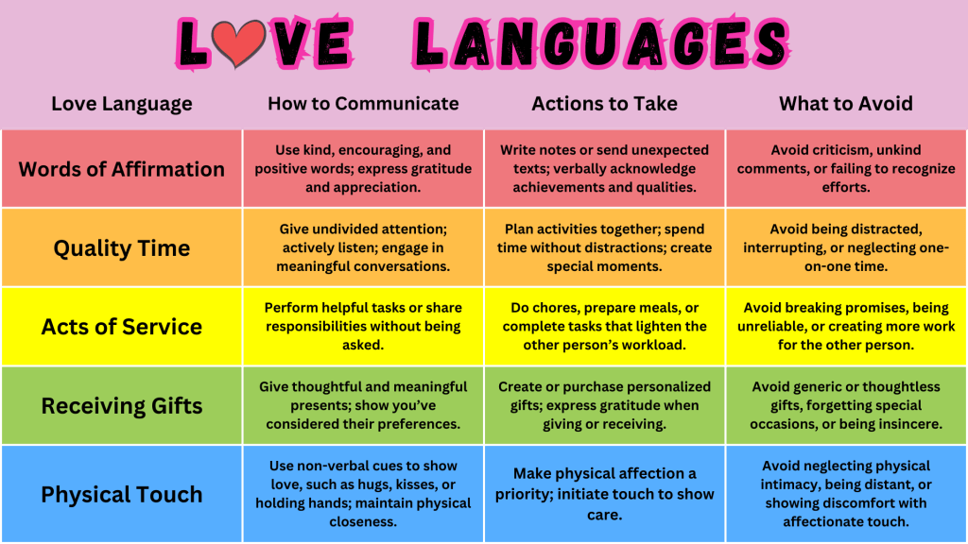
Leaders love language

Slide 19
Is leadership about a position?

Slide 20
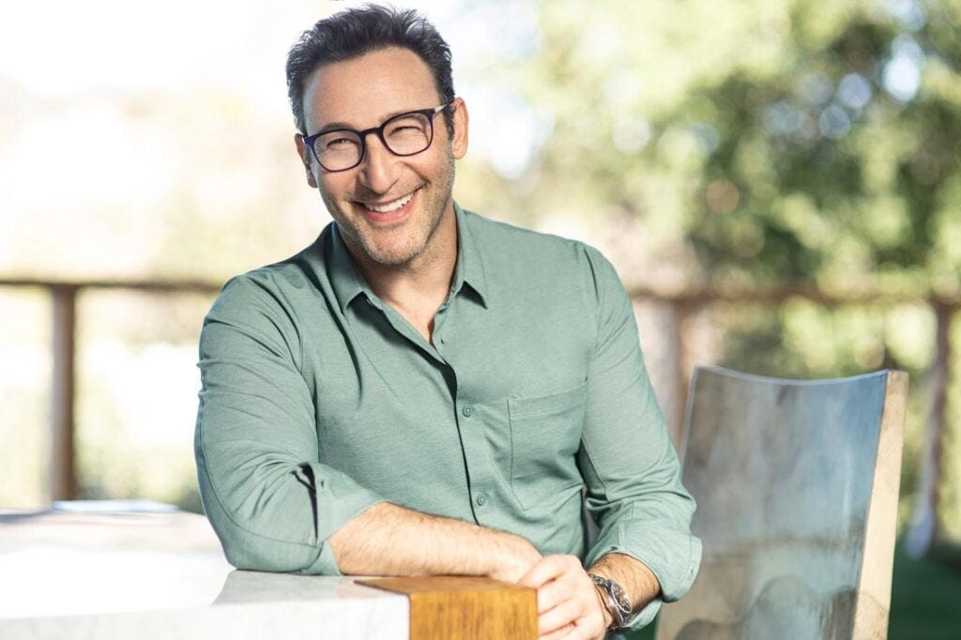
Importance of a roll model in leadership

Slide 21
Leadership is not a license to do less, it’s a responsibility to do more

Slide 22
Thank you

